Slide 1


Krems and Luxembourg and their wine history
The similarities of the wine history of Krems and Luxembourg
Jeanne Arens
KPH
Eramsus student

Slide 2
Contents
Comparison of Krems and Luxembourg
Krems
Luxembourg
Sources

Slide 3
Some basic facts
Krems
Luxembourg
Wine history since 3rd century AC
Grüner Veltliner
<40 monasteries
Winegrowers’ guild founded in 1447
Still very popular and a precious beverage
Wine history since 1st century BC
Pinot Gris
<50 winegrgowers
Winegrowes created the ”Les Domaines de Vinsmoselle” association
Still very popular and a precious beverage

Slide 4
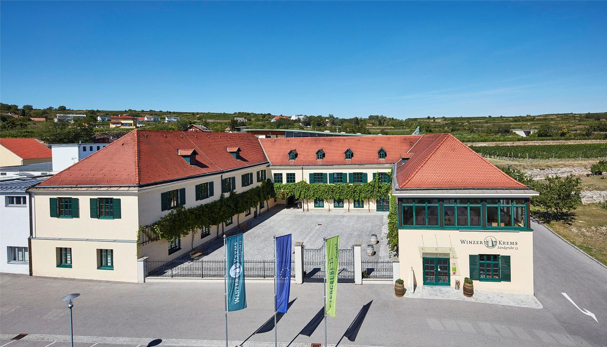
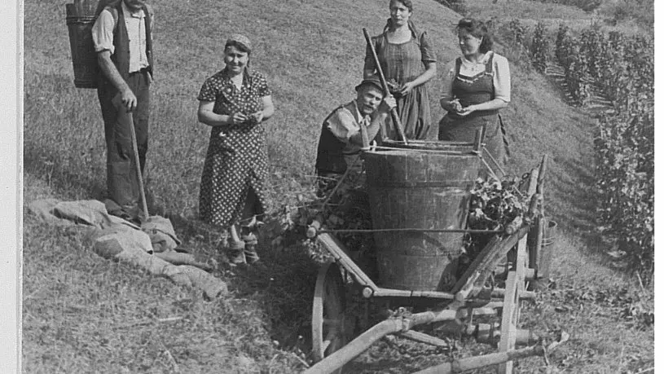
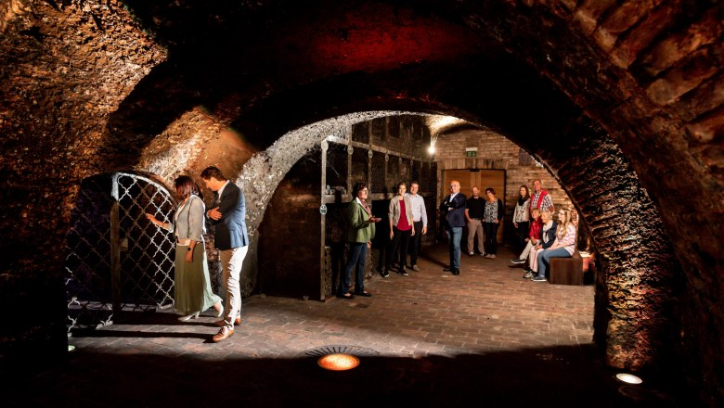
Krems
Winegrowers’ guild
Picture in the Kremser vineyard
Winecellar of the winegrowers’ guild

Slide 5
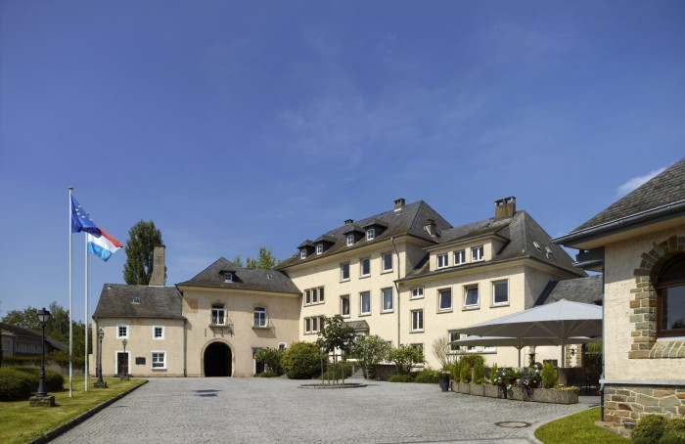
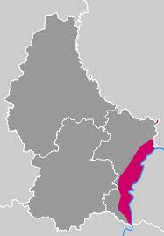
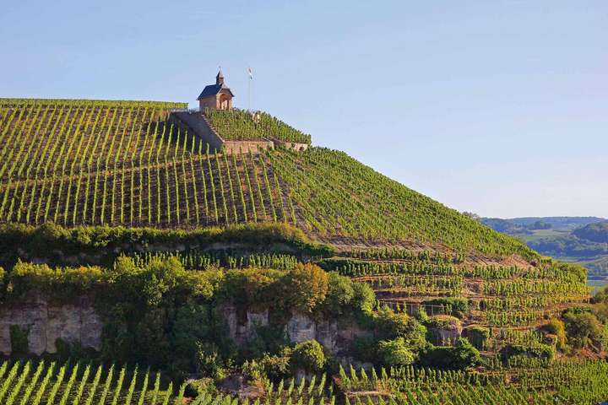
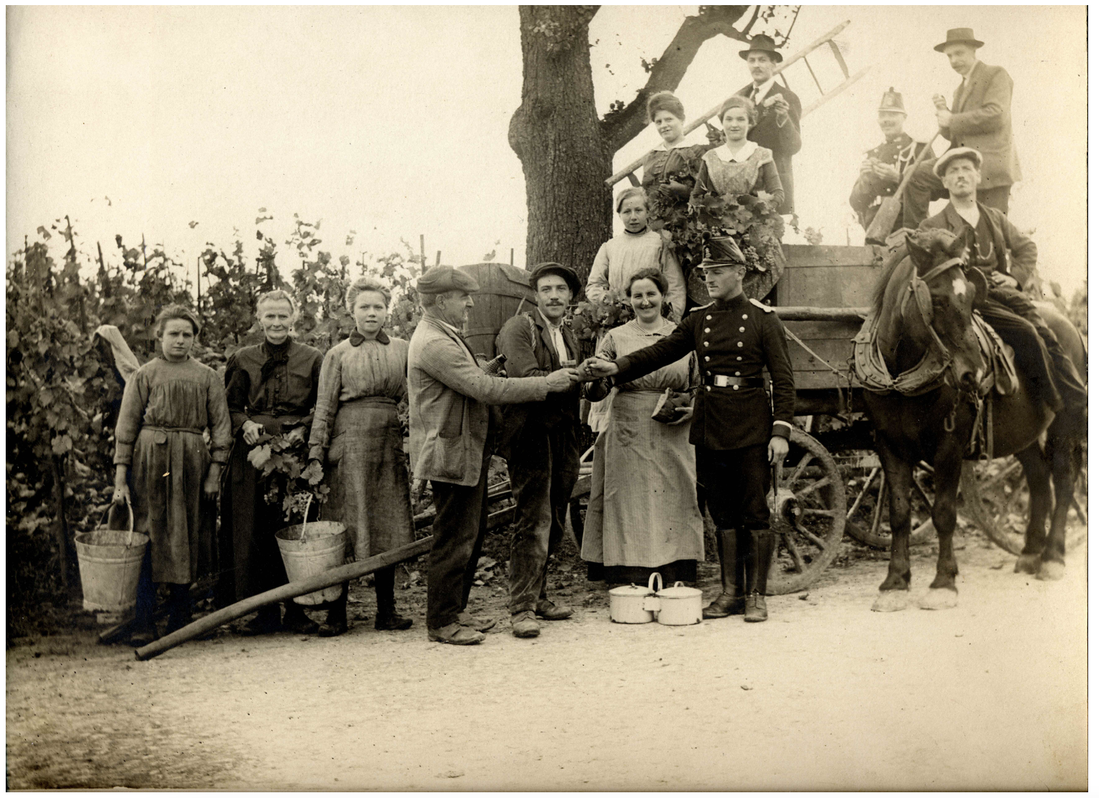
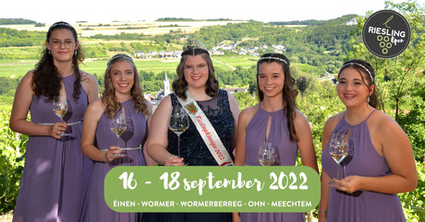
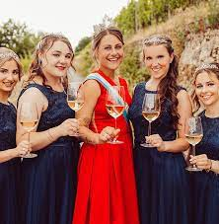
Luxembourg
Les domaines Vinsmoselles
Riesling queen 2022
Wine queen 2022
Picture in the vineyards 1883

Slide 6
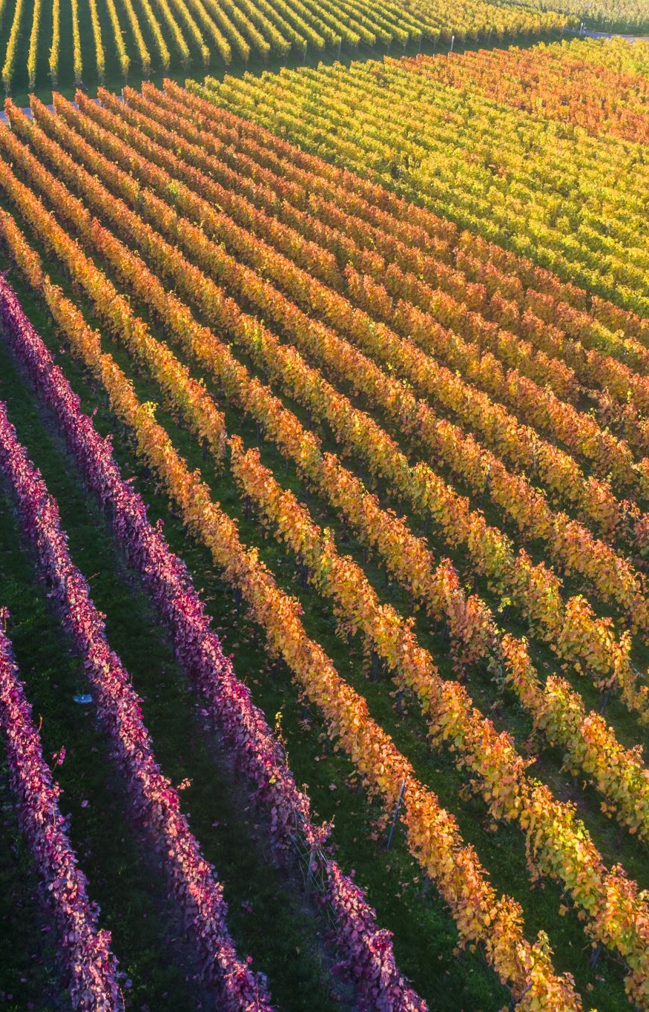
Sources
Telecran Mai 2001
Die Luxemburger Winzer und ihre Weine – Von Schengen nach Wasserbillig
https://weinfuehrer.wein.plus/weinregion/luxemburg
https://www.winzerkrems.at/ueber-uns/geschichte

Slide 7
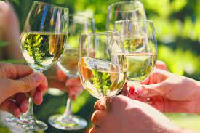
Thank you for your attention

